Slide 1
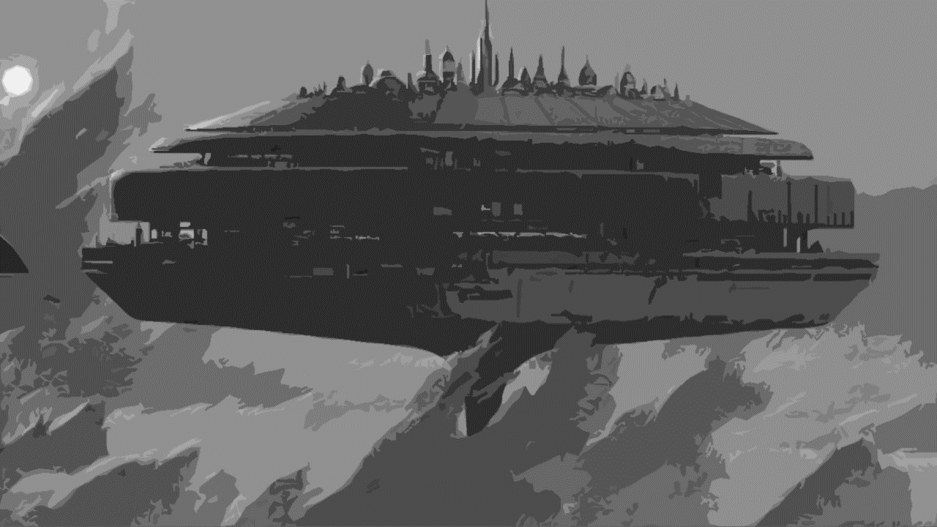
Venus Infinite
Venus Infinite
Narrative Design Document
Narrative Design Document

Slide 2


SUMMARY
SUMMARY
SYNOPSIS
LORE
VENUS CITY
VENUSIAN SYSTEM
CASTE
CHARACTERS
MINIONS
STORY

Slide 3

SYNOPSIS
SYNOPSIS

Slide 4

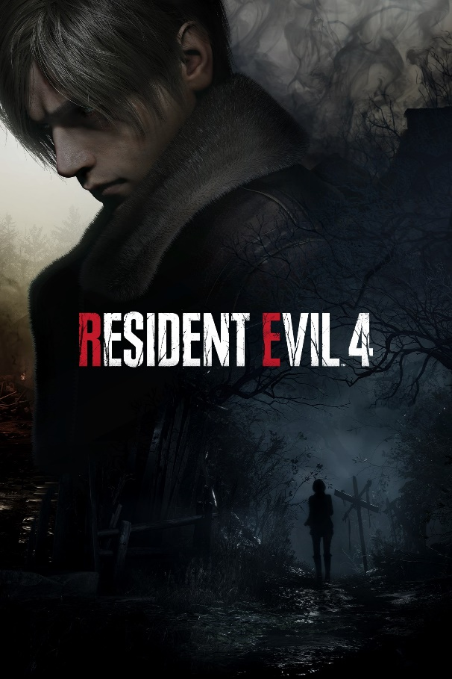

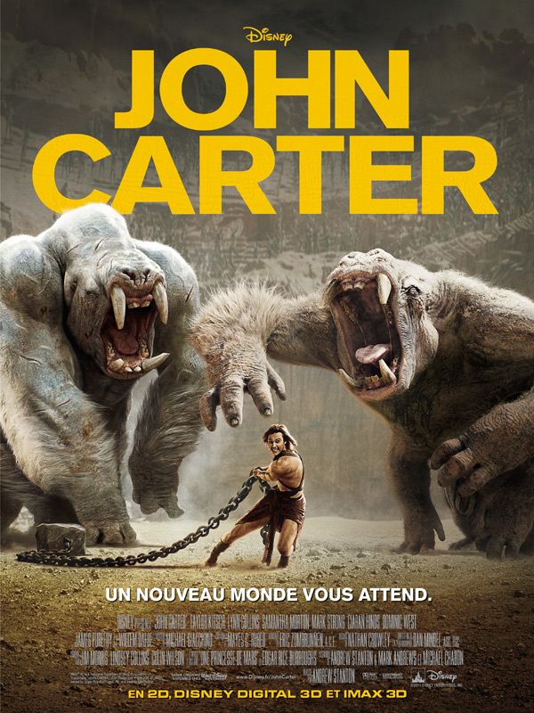
SYNOPSIS
SYNOPSIS
2350, as colonization of the solar system progresses, research leads to the discovery of an extraterrestrial civilization living in Venus upper atmosphere. Rumors of the potential resources to be found began, small groups of the richest company goes on expeditions.
Wikus Lee, a bounty hunter, is sent to find Andrew Bradman, a wealthy explorer, and discovers a city that seems utopian, but is filled with explorers infected by a strange virus that is gradually turning them into alien creatures.
X
X

Slide 5
lore
lore

Slide 6
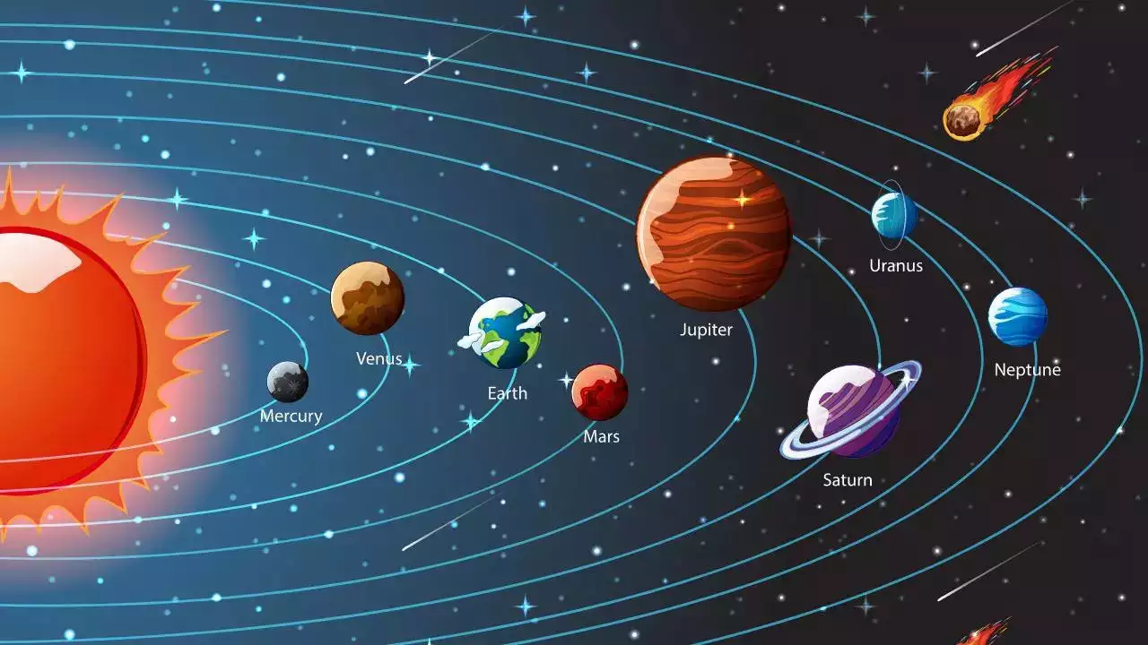
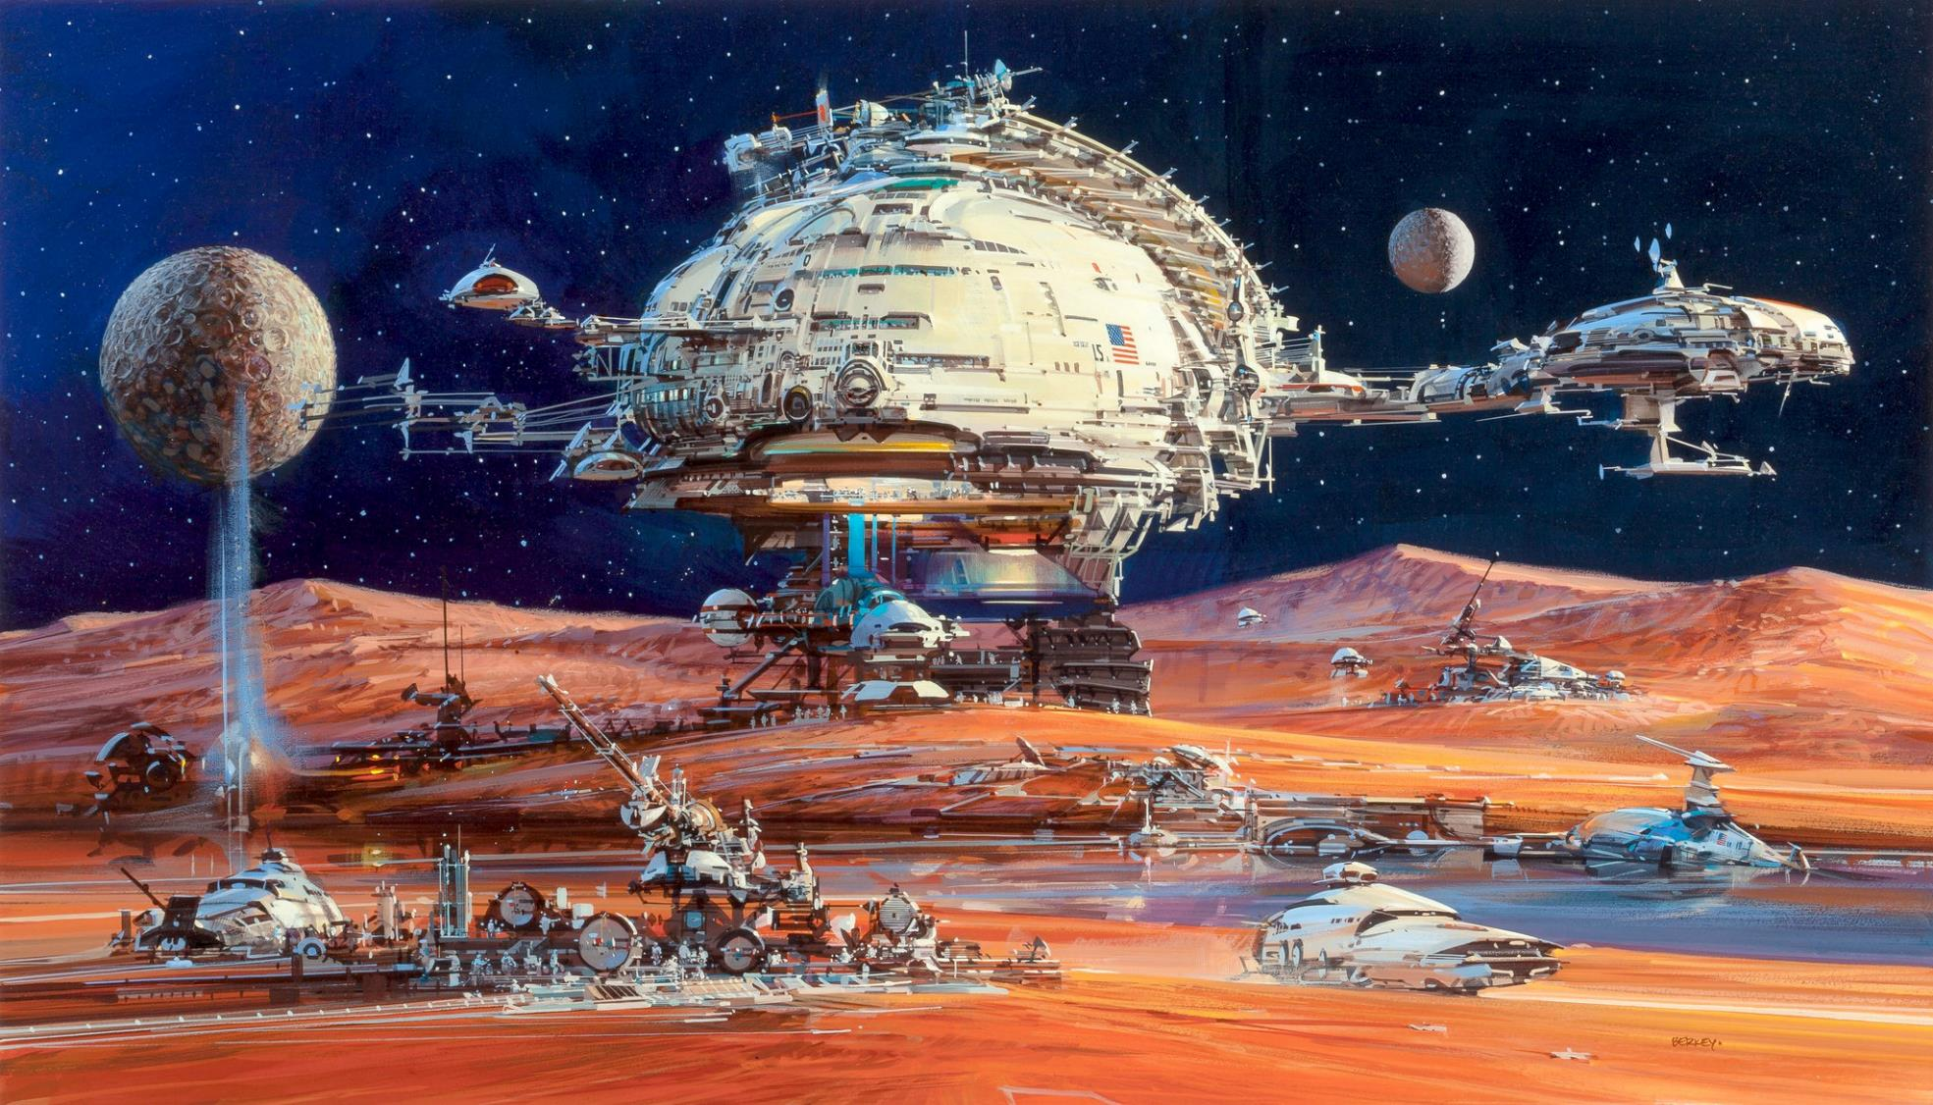
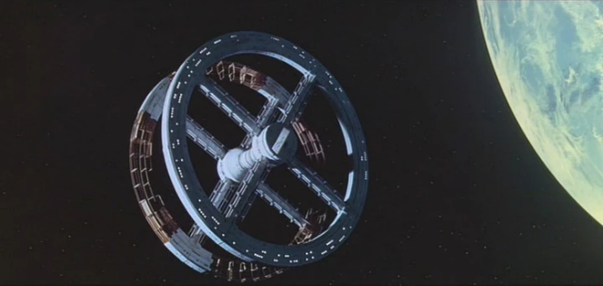
Lore – solar system
Lore – solar system
Colonised in solar system:
- Mars
- The moon
- Calisto & Europe (Jupiter)
- Some space stations
Colonised planet are mainly used to extract resources and commercial uses but some structures are made for travel, prisons or habitations for the richest ones.
Most of the people still live on earth and cant leave it.
It’s very hard to colonised new planet, only really rich people can do it and they need to be sure that there is enough resource to be worth.

Slide 7
Venus city
Venus city

Slide 8
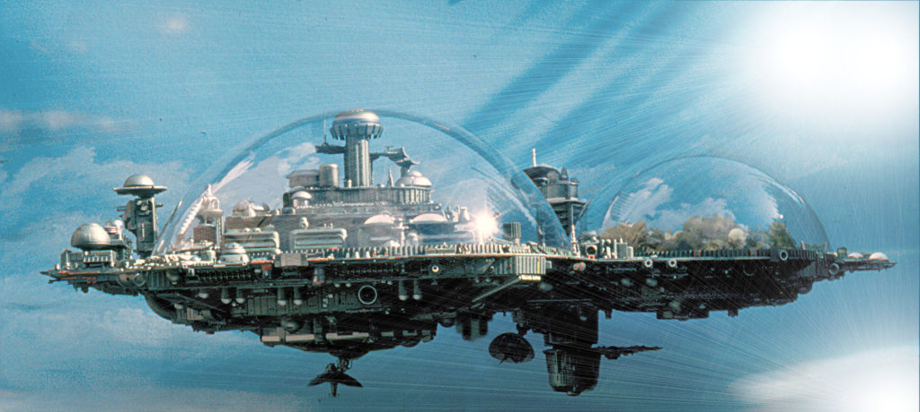
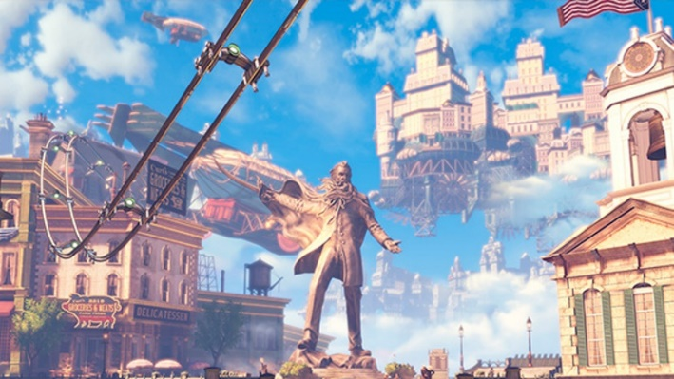
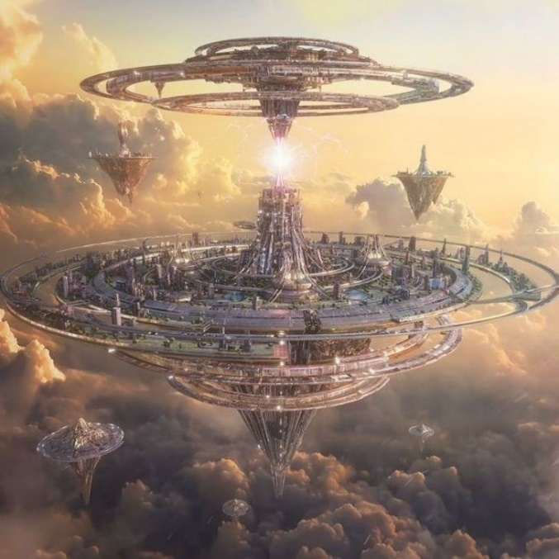
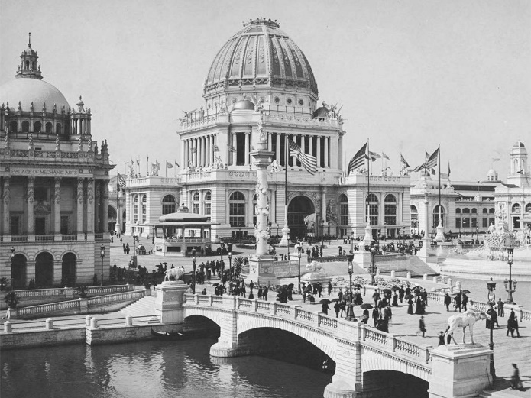
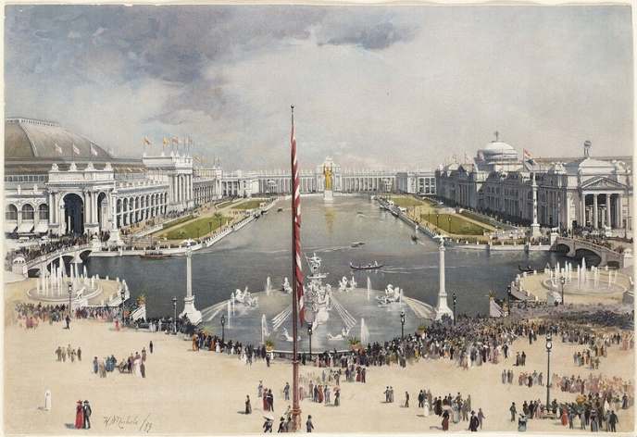
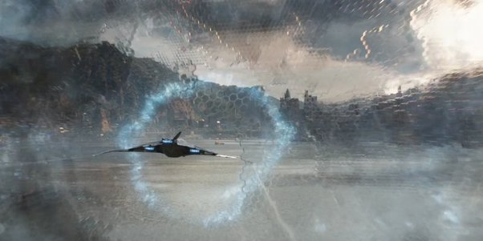
Venus City: Columburgh
Venus City: Columburgh
Alien were inspired be 20’s 30’s human constructions.
Alien were spying for thousands of years on earth and human evolution
Alien were hidding from human because they were affraid of what humans could do with their technologies and resources.
https://fr.wikipedia.org/wiki/Colonisation_de_Vénus#:~:text=La%20colonisation%20de%20Vénus%2C%20la,favorable%20à%20la%20présence%20de
https://www.numerama.com/tech/240108-conquete-de-lespace-faut-il-construire-des-cites-volantes-sur-venus.html

Slide 9
Venusian system
Venusian system

Slide 10
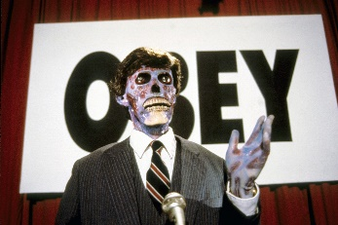
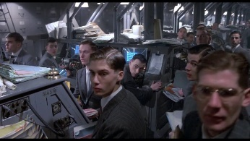
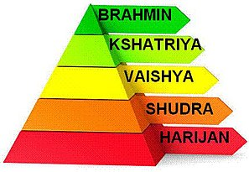
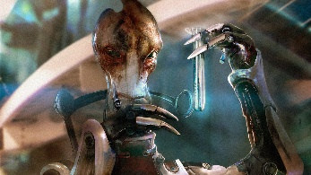
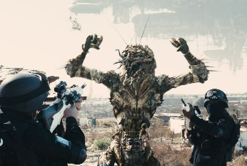
Venusian system - Caste
Venusian system - Caste
Leader
Leader
Scientist
Worker
Manager
Manager
Scientist
Inspired by Indian caste system
Worker

Slide 11
caste
caste

Slide 12
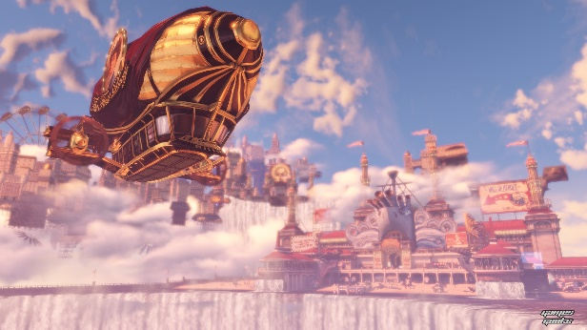
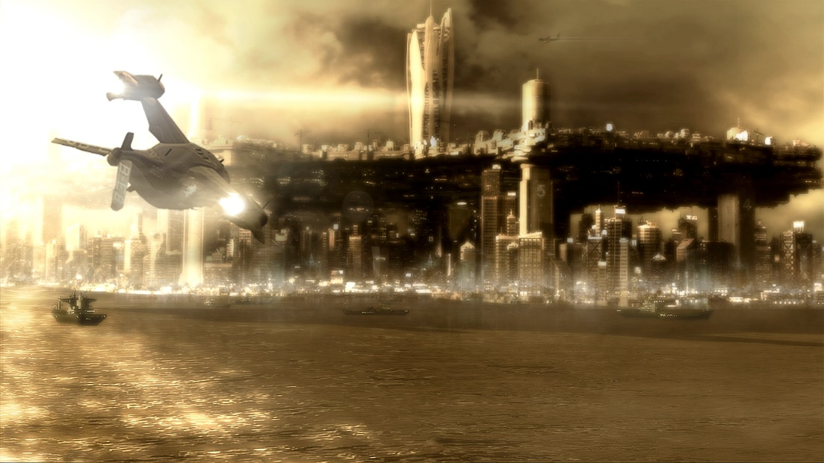
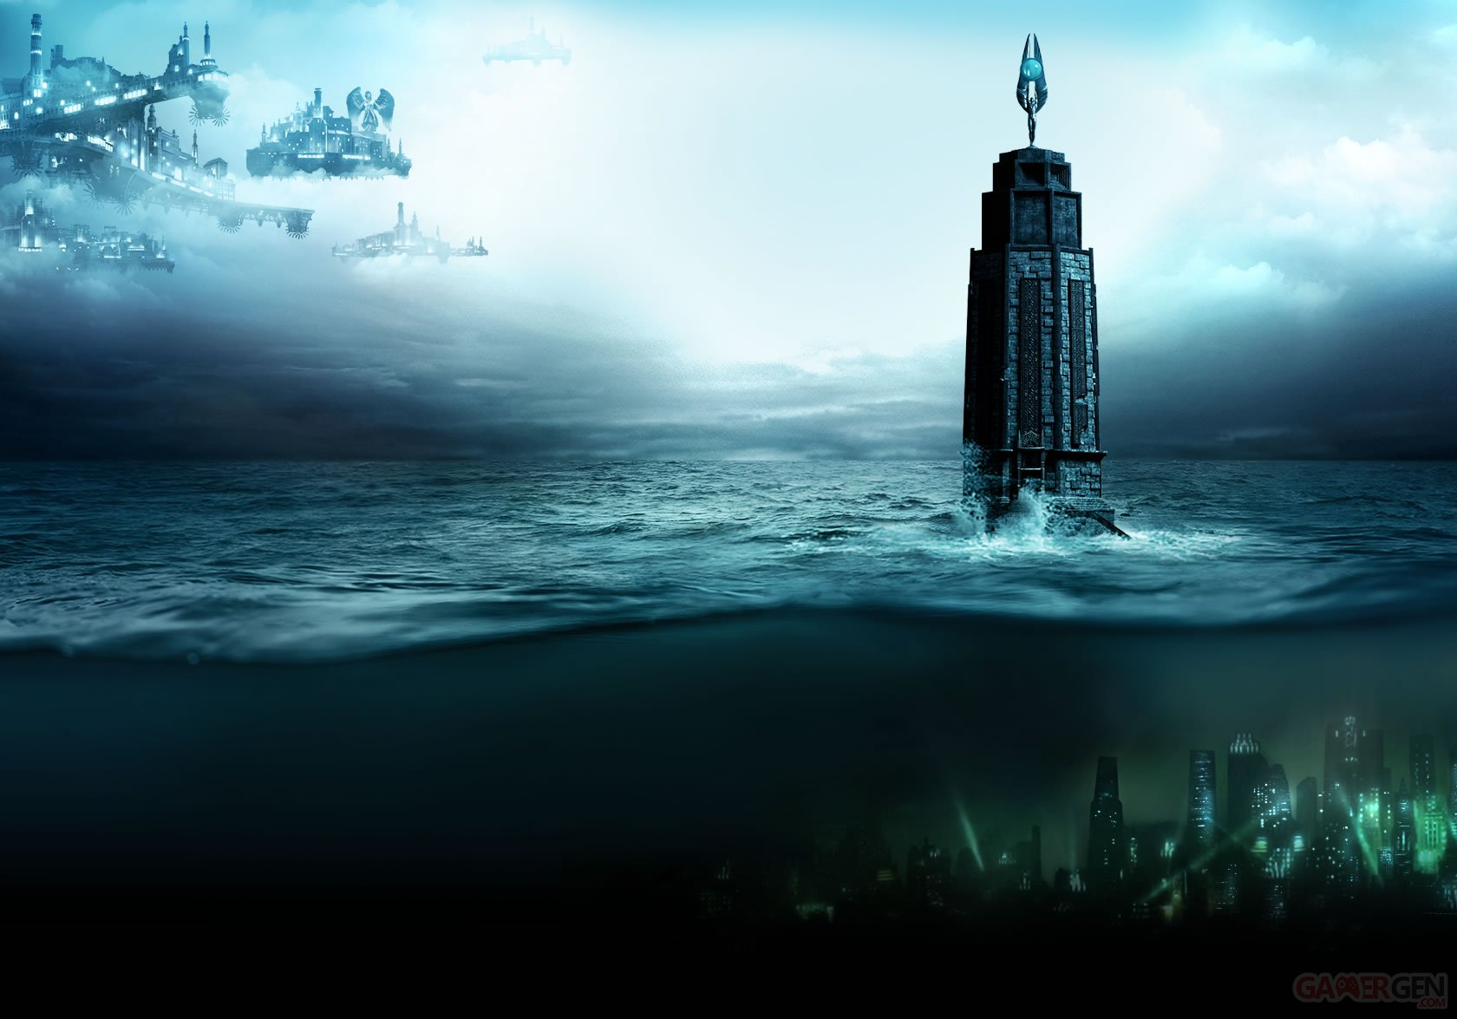
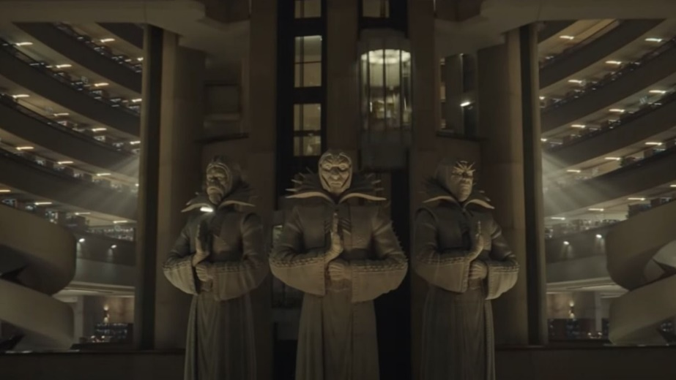
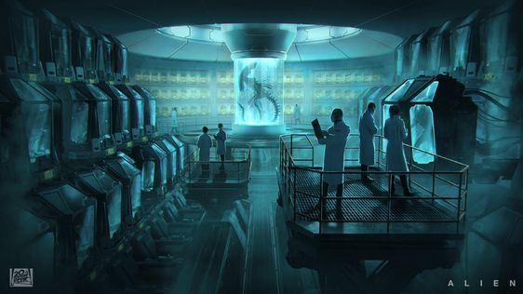
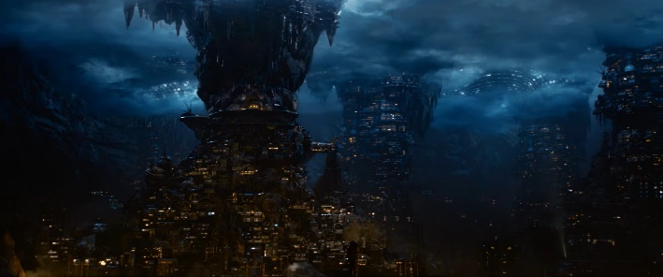
Caste - Floors
Caste - Floors
Each caste has it’s own floor
Prime City
Leaders lives in a main city that seems to be utopian
Theme: Air
Architecture: Neoclassical
Sublock
Managers lives just under Prime City in brutalist architectures
Theme: Earth
Architecture: Ecobrutalism
Rapturopolis
Some laboratories are hidden under manager floor, this is the biggest floor to prevent worker to go higher
Theme: Water
Architecture: Futurist lab
The station is split in 4 differents floor.
The lower levels are the worst they are with more gravity and higher temperatures.
There are differents access between floors that can be used by people depending on their castes and their roles.
Each floor has a specific architecture and a theme based on one of the 4 elements.
The Depths
The workers live at the lowest level where the conditions are the most extreme
Theme: Fire
Architecture: Slums

Slide 13

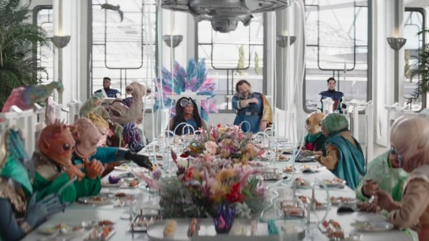
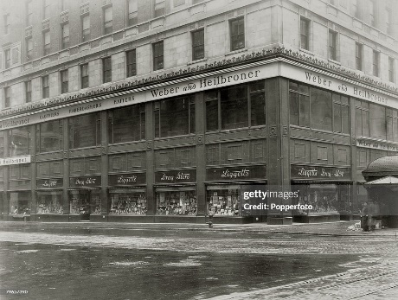
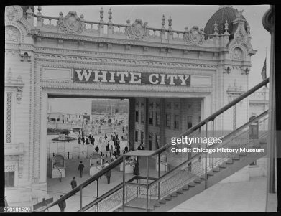
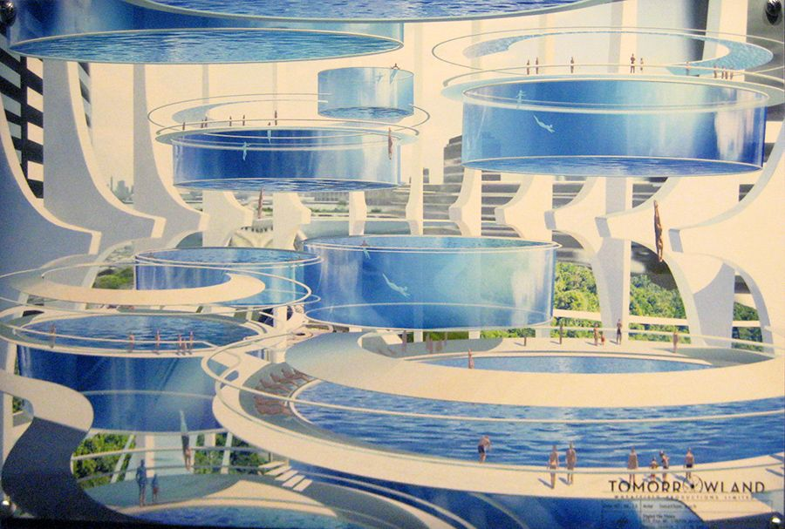
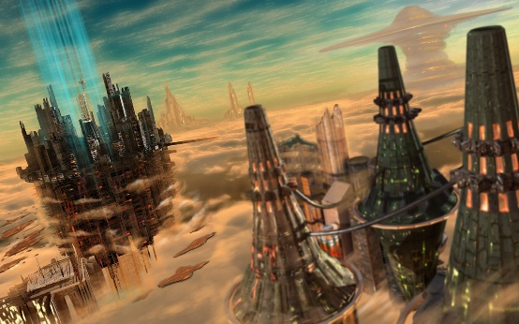
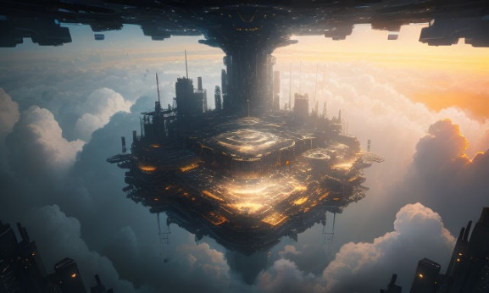
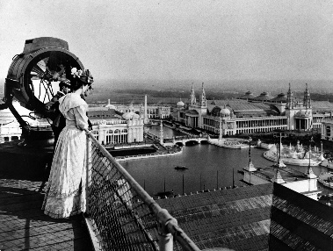
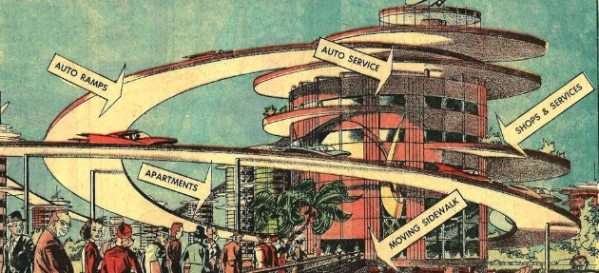
Caste - Leader
Caste - Leader
Wealthy, dont have to work. Almost considered as gods, feared by other caste. Never have to see worker, they have most of the developed technologies.
Dedicated to art and luxury.
Usually go tu luxury restaurants, casino, theater and other entertainement places including some with powers use.
Live in upper cities, using almost all technologies and entertainment with the best infrastructure.

Slide 14
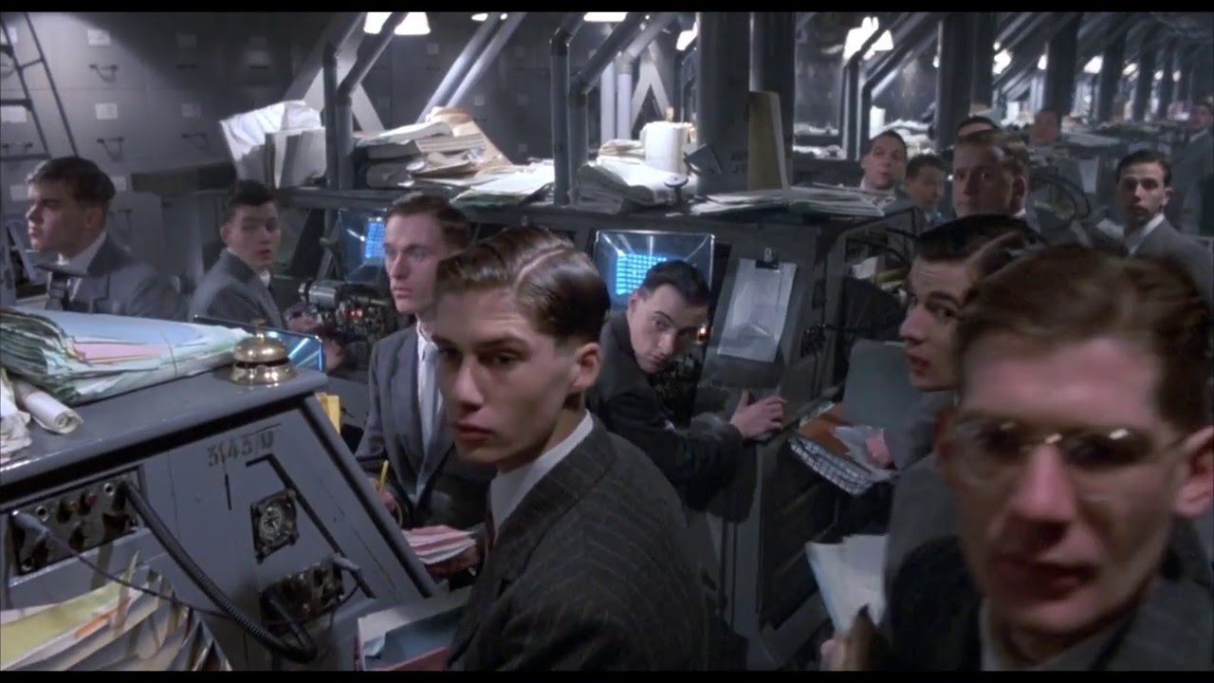
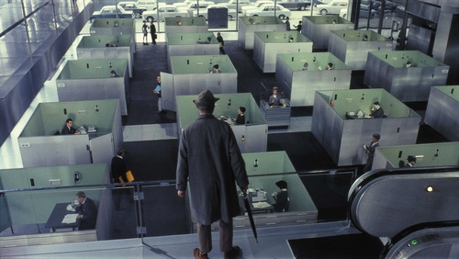
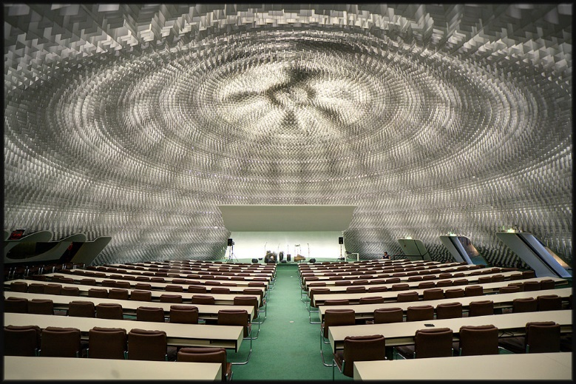
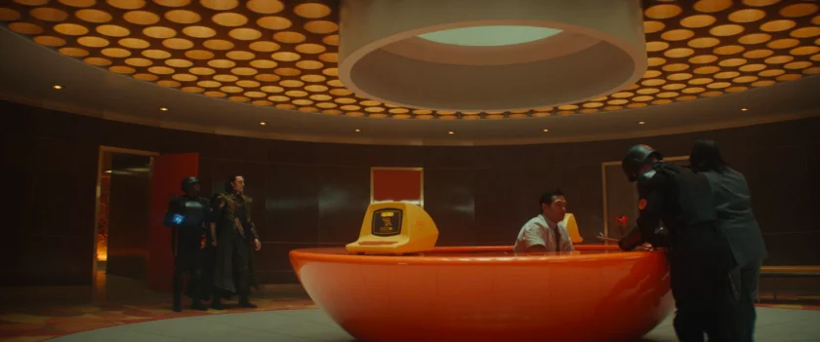
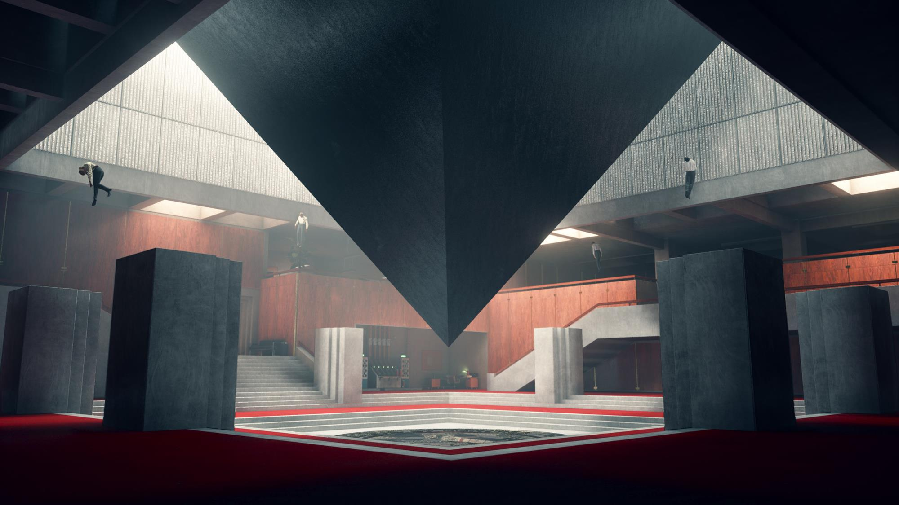
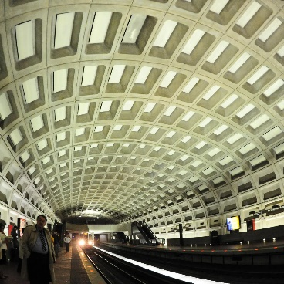
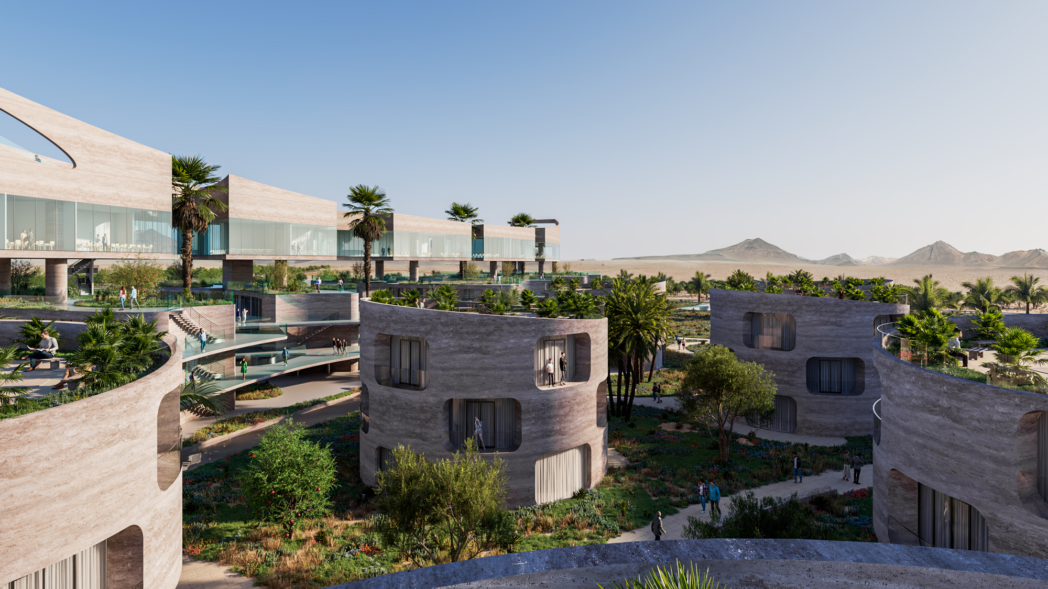
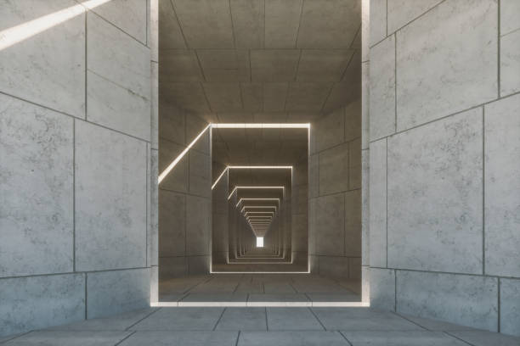
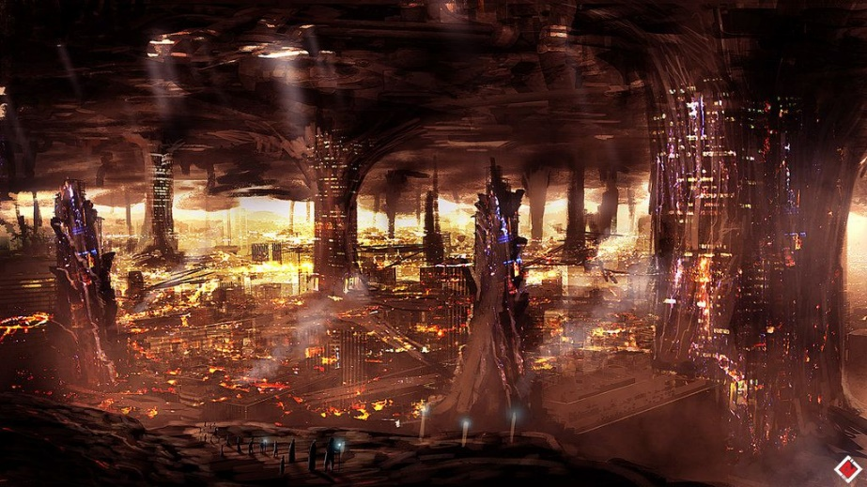
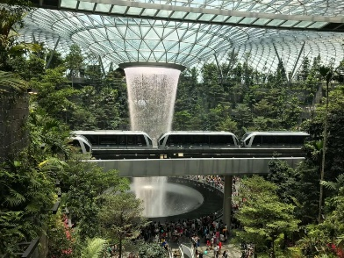
Caste - Manager
Caste - Manager
Sell worker’s resources to leaders
Can also be military to keep worker and scientist at their places, usually with powers and weapons.
Have a pretty good standard of living.
"Dehumanised", need to please leader to keep their places.
No real culture or entertainement, most of the time the leader’s one.
Live under cities in brutalist style architecture. They can go to cities, most of the time for business

Slide 15

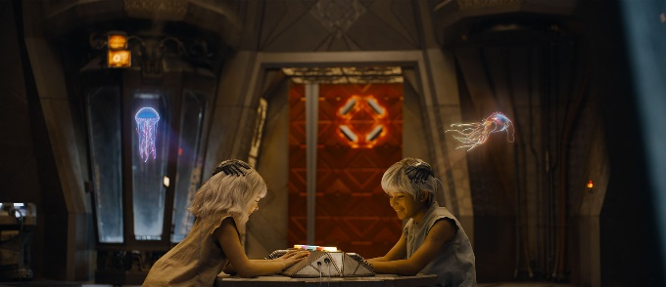
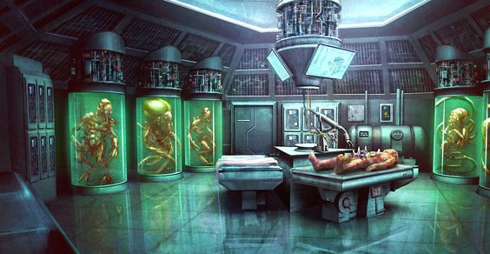
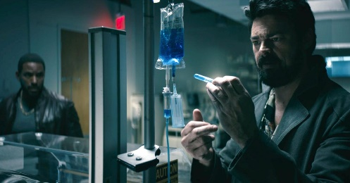
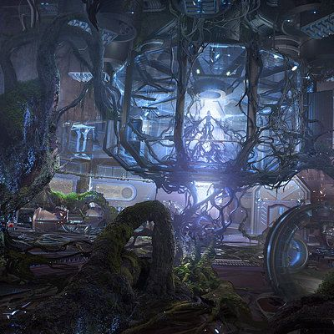
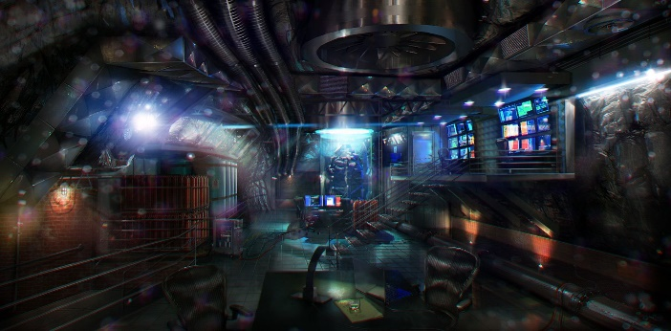
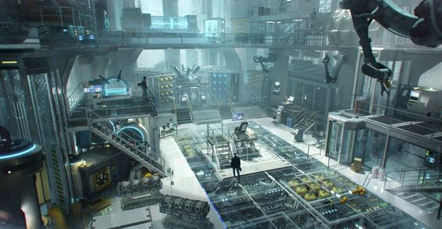
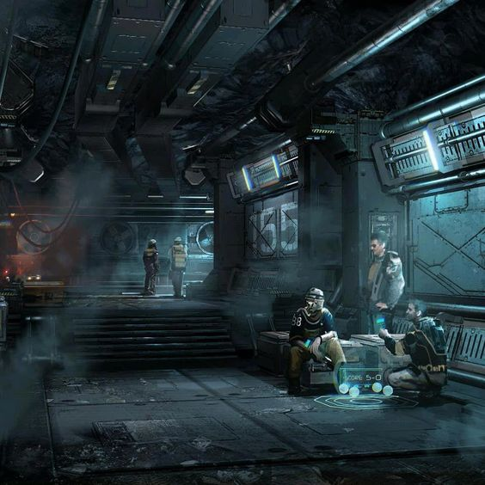
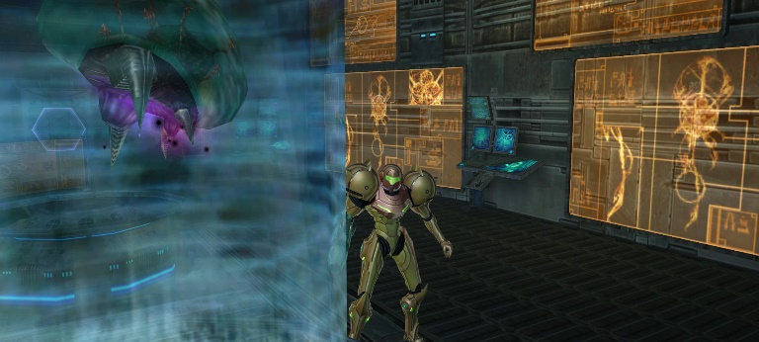
Caste - Scientist
Caste - Scientist
Make experience and test product on workers
Some really want to make their experiences, some try to change things but most of them just do their jobs.
Dont really have a lot but most of their lifes is focus on their works.
Have just what they need to live but not much more, almost no access to entertainment.
Live at a special hidden floor, kept secret to workers

Slide 16

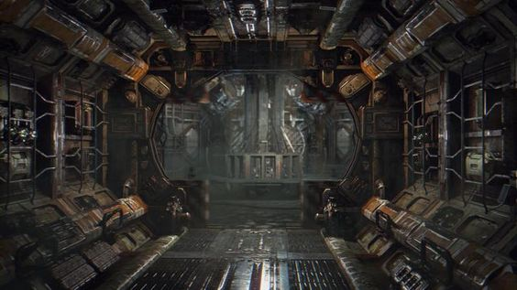







Caste - Worker
Caste - Worker
Exploited, has to work for the manager. Sometimes try to revolt but are stopped by the managers.
Has the lowest life expectancy and regulars accidents.
Can never go to other floor except when they are chosen to make experience for the scientist.
Have no access to powers or weapon.
have a despised local culture.
Live at the lowest level of the station with the poorest living conditions, highest temperature.

Slide 17
CHARACTERS
CHARACTERS

Slide 18


Characters – Main character
Characters – Main character
Name: Wikus Lee
Age: 34
Gender: M
Goal: Making contracts
Conflicts: Face danger but never consequences
Key life events: has been abandoned
Fears: Losing its humanity
What they value most: Honest work

Slide 19



Characters – Characters to rescue
Characters – Characters to rescue
Name: Andrew Bradman
Age: 42
Gender: M
Relationship to key characters: Beware, want to use him
Goal: Colonise Venus
Family: Wealthy from diamonds extractions on Neptune atmosphere
Education: Biggest economic/business school
Physical description: Elon Musk
Fears: Losing power
What they value most: What he call “potential” in humans

Slide 20



Characters – Alien scientist
Characters – Alien scientist
Name: Sunev
Age: 105
Caste: Scientists
Goal: Freeing workers
Family: Wealthy among scientists
Education: Very developped
Physical description: “Classical” alien creature with technological suit
Key life events: Was been in worker caste and adopt at a young age due to his skills
Fears: Get arrest for developing powers for workers caste
What they value most: Venusian’s people

Slide 21



Characters – Alien Worker
Characters – Alien Worker
Name: Otsillac
Age: 26
Goal: Supporting his family and find a way to escape The Depths
Family: Large
Education: None
Physical description: “Classical” alien creature
Key life events: Has build many tools from waste when he was working in landfill but was reprimand by soldiers
Fears: That his family does not survive well
What they value most: Venusian’s people

Slide 22
MINIONS
MINIONS

Slide 23






Minions
Minions
Mutants (Human)
Human with aliens physical aspect
Agressive, no real personality. Scary
Difformation that can be used to attack but can also be a weakness
Geccon (Alien soldiers)
Alien with weapons
Agressive, threatening
Some weaknesses on their armors
Fight with more actions than horror
Zegnaks (Aliens with powers)
Alien with upgraded powers
Agressive, scary
Some weakness that can be revealed with powers

Slide 24
STORY
STORY

Slide 25
Story Steps
Story Steps
Landing:
Discovering Prime City, mutants, first power and weapons
The Office:
Discovering alien soldiers and that Columburgh is split in different parts. Finding where is Andrew Bratman, he leads the player to the laboratory
The Lab:
Discovering how powers are made, player is sent to The Depths by aliens scientist and is separated to Andrew Bratman
Underground:
Discovering the exploitation that make Prime City so rich and that alien workers has now access to powers and develop mutations
Crusher:
Finding a way to get out of The Depths by going through a crusher to access an elevator
Back in town:
Getting back in Prime City, aliens workers and soldiers are in the city plunged into chaos
Final:
Last boss fight in a theater, combine every powers and enemies type.

Slide 26
Complete Story
Complete Story
Characters
Minions
Place
Landing
Wikus Lee land on Columburgh and start to explore to find Andrew Bradman. The city seems empty until he find humans with alien mutations. That’s where he realise the city is lock down and the number of mutants is increasing. He seems to be protected from infections by his suit.
Wikus also find that venusian can use powers for entertainment and decide to use them to fight by combining the powers with the telekinetic properties of his suit.
He try to find a shelter to learn more and go to a casino by using rails that are normally used to transport packages or entertainment. Once in a safe area he find a dead Geccon with a holographic wanted notice for Andrew and get a pass to go on a lower floor beneath Prime City.
Wikus try to find a way to use the pass. He find an elevator that has been shut down to prevent the pandemic and has to use the rail systems.
The Office
Once at a lower levels he arrive in a warehouse full of packages and find that there is a giant city beneath the first one: Sublock.
He is detected by Geccons and is chased, he escape and use vent and unused corridor to sneak around. Some of those corridors are occupied by a lot of mutants so Wickus has to open doors and spread mutants in offices and military base by using the pass he got in Prime City.
At some point he sees Andrew with Geccons going in a dark place. Wikus sneak into the room and neutralizes the soldiers.
Andrew is reassured but kept in an elevator, Wikus want to escape at the surface of the planet and Andrew tell him to press a specific button to open the elevator. When Wikus press it, Andrew is sent directly at a lower level. So Wikus decide to follow the elevator by using it’s rail system to get back to Andrew.

Slide 27
Complete Story
Complete Story
The Lab
Once in Rapturopolis Wikus quickly find Andrew and protect him from other Geccons with powers in the lab.
They understand that the laboratories seems to be used to make strange experiences and make powers. The further they go, the more they understand that the powers are developed on living subject with high death rates.
They quickly meet an alien scientist, Sunev, that lead them at distance by opening doors and giving them ammo at distance.
They eventually arrive in a giant room in wich they found Sunev that tell them to go to the last floor to give powers to venusian, Wikus try to decline but an alarm start and a giant alien monster is freed.
Once the giant is defeated, Andrew get the alien compound but tell Wikus he want to leave the planet now, that’s where Wikus realize that Andrew wanted to get resources before leaving the planet and make Wikus send him here on purpose.
Geccons arrives and start to threat the 2 characters. Andrew steal Wikus sky hook to leave while he try to fight Geccon and Sunev push him with compound to the last floor: The Depths.
Underground
In The Depths the temperature is the highest and the gravity is very strong.
Wikus fall in a landfill and break compounds and his suit, he try to repair it and understand that rails are also used to sent every trash of Columburgh here.
He try to explore but quickly find venusians that seems to be scared of him and try to hide when Wikus see one of them with a tool that look like a sky hook: Otsillac. He try to follow him when Geccons arrive and sow terror.
Some worker reacts and some of them seems to be developping powers and become Zegnaks, on the other side Geccons try to block all the population. The chaos grow.
Wikus continue and try to find Otsillac while being attacked by Zegnaks and Geccons. He finally get in a small house in wich he found him. He understand that the alien work in a crusher and that there is a way to get directly to Prime City by using a rail, Wikus will need another sky hook and try to ask Otsillac to make one.
He finish to understand that they need to go to the crusher to get resources, Otsillac agree to make his own sky hook to go to Prime City.

Slide 28
Complete Story
Complete Story
Crusher
Otsillac lead Wikus to the crusher, the chaos grow in The Depths so Wikus try to protect Otsillac but they still need to take alternative route. Otsillac make different tools to move forward.
In the same time, Zegnaks riots and start to gain ground against Geccons.
Once in the crusher a small group of Zegnaks appear and there seems to be a leader with magnetic powers, a long fight start while Otsillac try to make sky hooks. Wikus succeed and Otsillac give one sky hook to Wikus and go back to his family with others to make them leave.
Wikus finally use a rail to get back to Prime City.
Back in town
Wikus get back to Prime City, the chaos has taken all of Columburgh and the city is now filled with mutants, Geccons and Zegnaks fighting.
Wikus has now developped many powers and there seems to start increasing. He try to get back to his ship to leave the planet but all path are block, Wikus make his way through the chaos by using rails and his powers.
Once close to his ship Wikus see Andrew using rails to go to a ship before it’s destroyed by Zegnaks. Wikus decide to get back to the city to bring him back.
He get back to the other way and finally see Andrew getting in a theater, he follows.
Final
Wikus get in the theater and find Andrew Bradman, infected lose his mind and attack him with all sort of powers.
As the fight continue some mutants, Geccons and Zegnaks appear and are used by Andrew and his powers.
Wikus defeat him by using all his powers, rails and weapons to attack at every angle and destroy all his weaknesses.
He carry Andrew on his back to bring him back to Callisto and go his ship with rails and leave the planet.
Once he leave the planet, Wikus can take off his helmet set the ship to auto pilot and go to Callisto, then he realise that he is bleeding and his blood is green.
Wikus is infected.

